Slide 1

Maturity Gate – AI4HyDrop Project SESAR Solution 0450 – Autonomous Flight Plan Approval Service Maturity level TRL2
Project Coordinator: Aurilla Aurelie Arntzen Bechina, USN
Solution Leader: Emre Koyuncu, ITU
Brussels, 11 September 2025

Slide 2
Dr. Emre Koyuncu (ITU) Scope Validation path before the maturity gate Benefits of the SESAR Solution Maturity assessment Maturity concerns

Slide 3
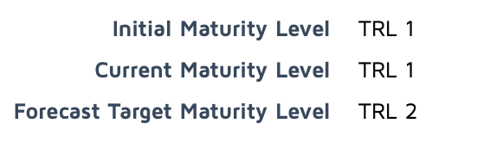
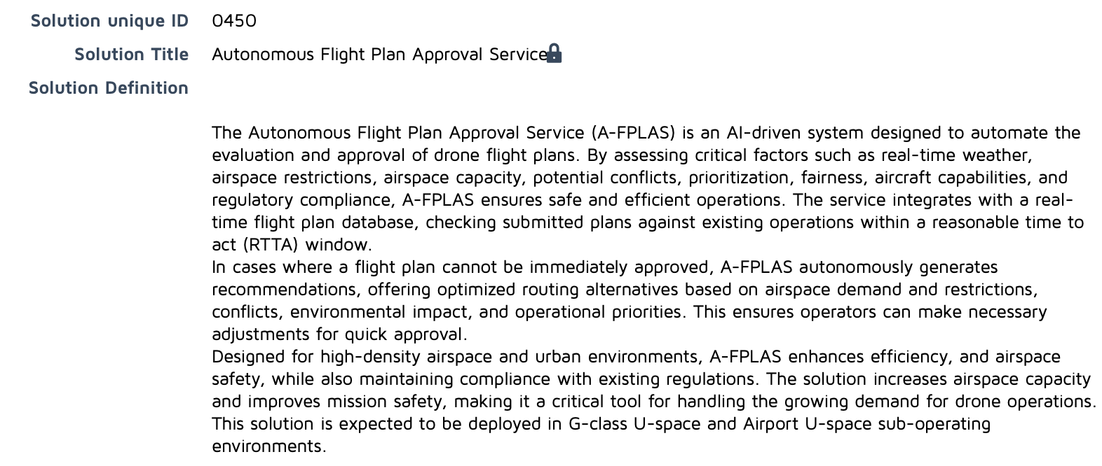
SESAR Solution 0450 Definition and Description

Slide 4
SESAR Solution 0450 Definition and Description
As drone operations continue to increase in complexity and volume, safely integrating unmanned aerial systems into the airspace poses significant challenges. One of the key hurdles is managing the approval process for drone flight plans considering that this process can be time consuming or immediate approval isn’t feasible.
The Autonomous Flight Plan Approval Service (A-FPLAS) addresses these challenges by providing a fully autonomous, AI-driven solution that evaluates, validates, and approves flight plans submitted by drone operators.
Autonomous Flight Plan Approval Service (A-FPLAS) is an AI-driven system designed to autonomously evaluate and approve flight plans submitted by drone operators. The system assesses critical factors such as weather conditions, airspace restrictions, aircraft capabilities, and legal constraints to ensure safe, compliant, and optimized operations. A-FPLAS integrates with a real-time database through Common Information system(CIS), containing all approved flight plans within a designated RTTA window. This allows for efficient conflict detection by comparing new flight requests with existing operations, while considering airspace demand, capacity, and environmental impacts. In cases of congestion, prioritization rules are applied to facilitate high-priority flights. The service also continuously evaluates the evolving airspace environment, offering real-time updates to help operators make informed decisions. If any issues arise during the evaluation, the system provides tailored recommendations for resolving conflicts or optimizing routing, ensuring safe and efficient airspace usage.
The Autonomous Flight Plan Approval Service (A-FPLAS) is fully compliant with international and European regulatory frameworks, including ICAO, EASA, and EU Implementing Regulation 2012/664. It supports the U-Space framework under SESAR 3 JU for safe drone integration into airspaces. A-FPLAS adheres to EU Regulations 2019/945 and 2019/947, ensuring compliance with drone operations and airworthiness standards, while enabling advanced capabilities like BVLOS and autonomous flights. By dynamically managing flight plans and integrating flexible airspace usage, A-FPLAS ensures safe, efficient, and regulation-compliant operations. This solution delivers key benefits in terms of mission efficiency, safety, and airspace capacity by providing real-time updates and seamless communication with unmanned traffic management (UTM) systems. Its AI-driven architecture facilitates faster approvals and enhanced decision-making, ensuring that drone operators can safely and efficiently navigate the airspace while minimizing environmental impacts.
Technological Solution

Slide 5

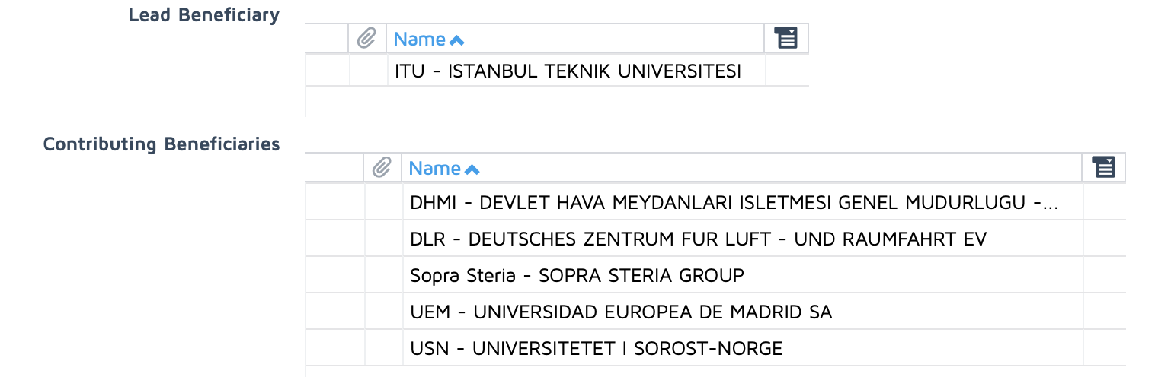





SESAR Solution 0450 Leader and Contributors

Slide 6
SESAR Solution 0450 – Link to Previous SESAR Solutions
Project | Full Title | Inputs to AI4HyDrop | AI4HyDrop Ambition
Metropolis 2 | A unified Approach to Airspace Design and Separation Management for U-space | Traffic management mechanism for high-density urban airspace with strategic conflict resolution | Automated flight plan assessment for strategic conflict resolution
CORUS | Concept of Operation for U-space | U-space structure and service definitions given in U-space ConOps document | Provide a working and validated mechanism for Drone Operational Plan Processing
SAFEDRONE | Increase Safety Level of Drone Operations | On-board trajectory re-planning mechanism and autonomous coordination generation | Autonomous strategic flight plan approval providing adaptivity to dynamic structure of airspace
USIS | Ensuring U-space Services are Safe and Secure | Flight request analyzing mechanism, rules of to be approved or declined | Autonomous approval mechanism with explainability
CORUS-XUAM | Concept of Operation for U-space | Flow chart/ operational processes such as landing on controlled airfield could be adapted for landing on vertiport, tactical deconfliction processes will be evaluated against work done in task 3. | A new set of Flow chart/ operational processes for each capability considered in AI4Hydrop will be defined
No directly linked solution in SESAR Solution Catalogue

Slide 7
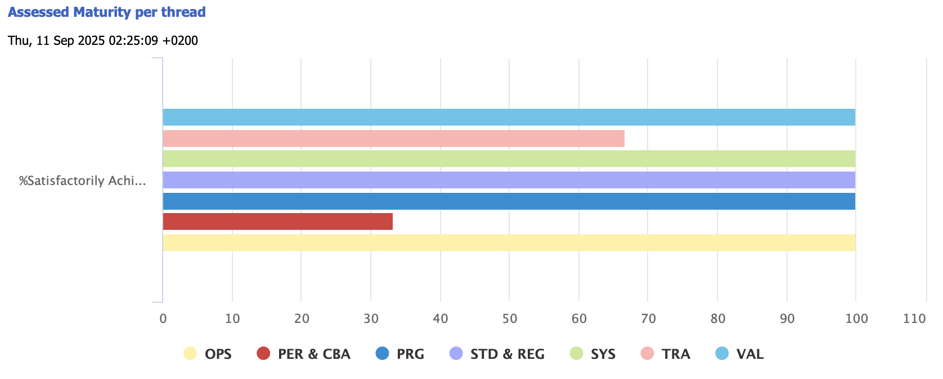
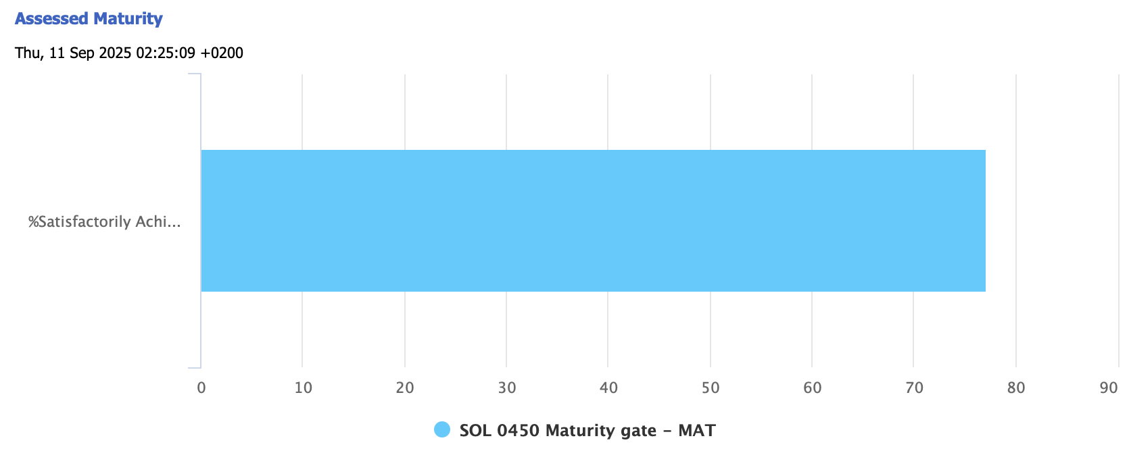
SESAR Solution 0450 Maturity Assessment
This template is applicable to DES HE solution projects

Slide 8
SESAR Solution 0450 Maturity Assessment
0450 - 11b Maturity Assessment Criteria.xls
This template is applicable to DES HE solution projects

Slide 9
SESAR Solution 0450 – Validations
Exercise #02 validation objective ID | Exercise #02 validation objective title | Exercise #02 success criterion ID | Exercise #02 success criterion | Sub-operating environment | Exercise #02 validation results | Exercise #02 validation objective status
OBJ-SOL0450-ERP-001 | Flight Plan Compliancy Check | CRT-0450-TRL2-ERP-OBJ1.001 | Successfully apply to all received flight plans and return compliancy check results within RTTA. | U-space or geo-zone for UAS flights in G-class airspace up to VLL, urban area (Prague) | The system successfully assessed flight plan compliance against spatial continuity, scheduling, and restricted area intrusion. Compliancy checks were executed in real time for each U-plan. | OK
OBJ-SOL0450-ERP-002 | Flight Plan Conflict Check | CRT-0450-TRL2-ERP-OBJ2.001 | Successfully apply to all received flight plans within a single RTTA window and return results enabling real-time assessment for flight plan approval or rejection. | U-space or geo-zone for UAS flights in G-class airspace up to VLL, urban area (Prague) | The system handled up to 55 operations and 500+ volumes, detecting spatial-temporal conflicts at 50Hz and issuing approval/rejection decisions within RTTA. | OK
OBJ-SOL0450-ERP-003 | AI-based Flight Plan Recommendation | CRT-0450-TRL2-ERP-OBJ3.001 | Successfully apply to all received flight plans within a single RTTA window and return approval or rejection, if rejected return with the reason. | U-space or geo-zone for UAS flights in G-class airspace up to VLL, urban area (Prague) | The system provided rejections with detailed reasoning for non-approvable U-plans based on trajectory conflicts or regulation breaches. | OK
OBJ-SOL0450-ERP-003 | AI-based Flight Plan Recommendation | CRT-0450-TRL2-ERP-OBJ3.002 | Successfully apply to all rejected flight plans within a single RTTA window to recommend operator with the potential alternative actions to solve identified problems. | U-space or geo-zone for UAS flights in G-class airspace up to VLL, urban area (Prague) | The system used HRL agents to recommend fair, conflict-free alternatives for rejected U-plans. Recommendations adhered to operator preferences, demand heatmaps, and population density. | OK

Slide 10
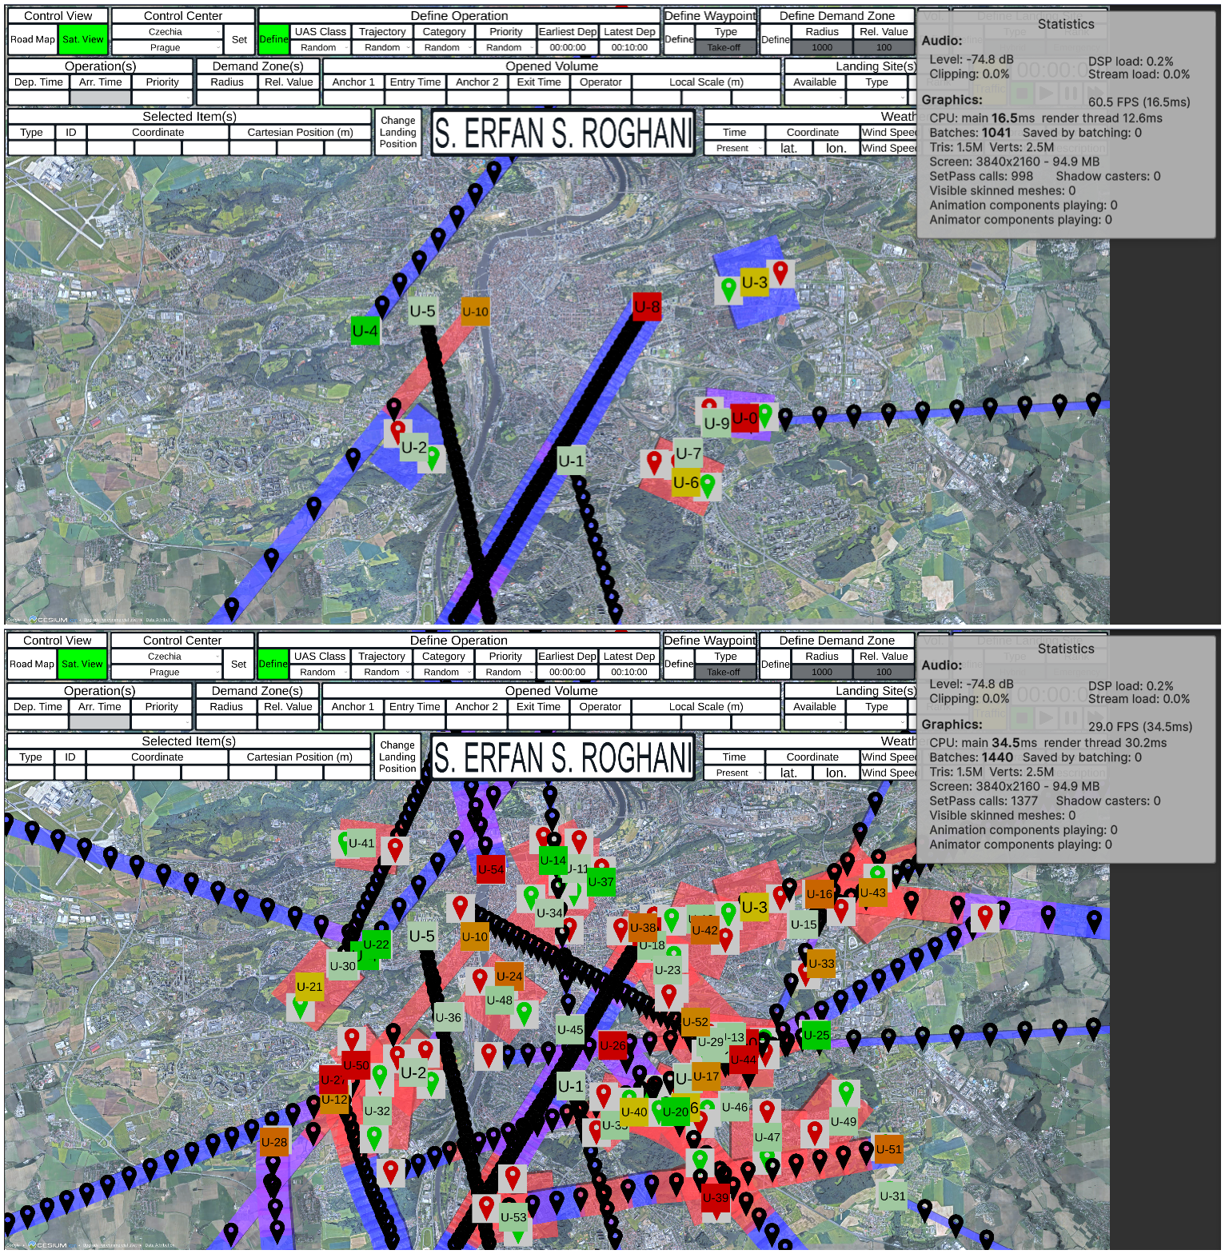
SESAR Solution 0450 – Validations
Scenario 1: System Scalability Test
Key features of the scenario include:
Location: Prague
Time: Weekday peak operational window
Traffic Density: Initially 11 operations; scaled to 55 operations to simulate sudden demand surge
Trajectory Types: Mixed (linear and area-based trajectories)
Regulatory Framework: All operations are evaluated against U-space rules and assumed to pass all checks except conflict.
The only reason for a U-plan rejection in this scenario is a detected 4D conflict with another pre-existing plan. In such cases, the operator receives a system-generated trajectory recommendation that aims to resolve the conflict fairly and within operational constraints.

Slide 11
SESAR Solution 0450 – Validations
Scenario 1: System Scalability Test
Metric | Description | Value In Baseline Subscenario | Value in Stress Subscenario
Conflicts Detected | Total number of 4D spatial-temporal conflicts detected | 2 | 14
Conflicts Resolved | Number of conflicts successfully resolved by A-FPLAS | 2 | 14
Average Time to Resolve | Mean time taken by the system to produce a valid recommendation | 95 seconds | 180 seconds
System Frame Rate | Average frame rate during scenario execution (Unity FPS) | 56 frames/second | 25 frames/second
Delay in Response (if any) | Number of cases exceeding the 5-minute RTTA window | 0 | 1
Degraded Service Conditions | Whether performance drops below acceptable levels under heavy traffic load | No | No
The System Scalability Test demonstrates that the A-FPLAS framework scales effectively in dense urban environments under sudden increases in operational demand. The real-time conflict detection engine operates stably, and the A-FPLAS hierarchy is capable of proposing fair and feasible alternatives within the RTTA window in most cases.

Slide 12
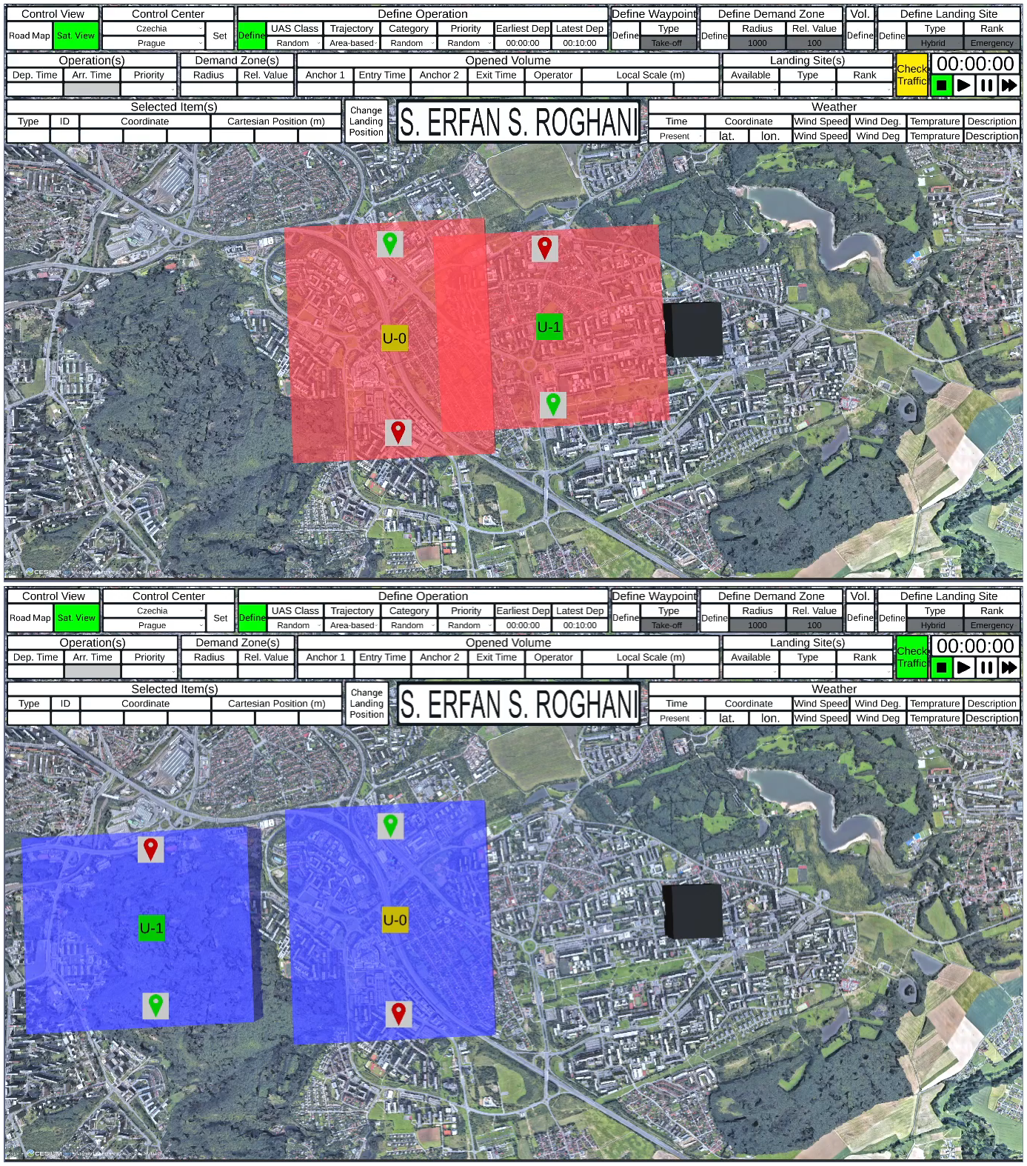
SESAR Solution 0450 – Validations
Scenario 2: Integration with Dynamic Airspace
Key Scenario Characteristics:
Location: Prague city center
Time: Weekday peak operation period
Traffic Density: High; 2–3 drone operations per hour with overlapping schedules
Trajectory Types: Mixed (linear and area-based)
Environmental Dynamic: Wind conditions influencing airspace structure in real time
The primary focus of this scenario is to assess the AI system's ability to incorporate dynamic weather-based constraints, specifically those derived from wind-related risks, and to adjust the trajectory approval logic accordingly.
Metric | Description | Value
Wind-induced Conflicts | Number of conflicts triggered by restricted zones resulting from wind | 1
Response Time | Time taken to generate an alternative trajectory from the moment of conflict | 11 seconds
System Performance Degradation | Any observed reduction in responsiveness or accuracy under dynamic loads | No
This validation scenario demonstrates that the A-FPLAS framework is capable of integrating dynamic airspace changes caused by weather conditions.

Slide 13
SESAR Solution 0450 – Validations
Scenario 3: Compliance and Safety Audit
Key Scenario Features:
Location: Prague city center
Time: Weekday peak operational window
Traffic Density: High; 2–3 overlapping operations per hour
Trajectory Types: Mixed (linear and area-based)
Regulatory Context: Compliance with standard airspace rules and local regulations
This scenario focuses on whether flight plans approved or modified by A-FPLAS adhere to both operational safety rules and formal compliance protocols.
Metric | Description | Value
Incomplete Trajectory Detection Average Time | Time taken to detect structural issues upon UCIS U-plan retrieval | 15 Seconds
Conflict Detection Frame Rate | Simulator frame rate while checking conflicts (target: 50 FPS with 400 volumes) | 48 FPS with 454 volumes
Visual Feedback Events | Number of warnings triggered (trajectory gaps, restricted area intrusions) | 13 warning for incomplete operations and 1 warning for restricted area intrusion
The simulation confirms that A-FPLAS is capable of; Continuously validating trajectory completeness; Preventing overlap with restricted areas in real-time; Maintaining simulator responsiveness even under high operational loads; Incorporating fallback mechanisms for user feedback.

Slide 14
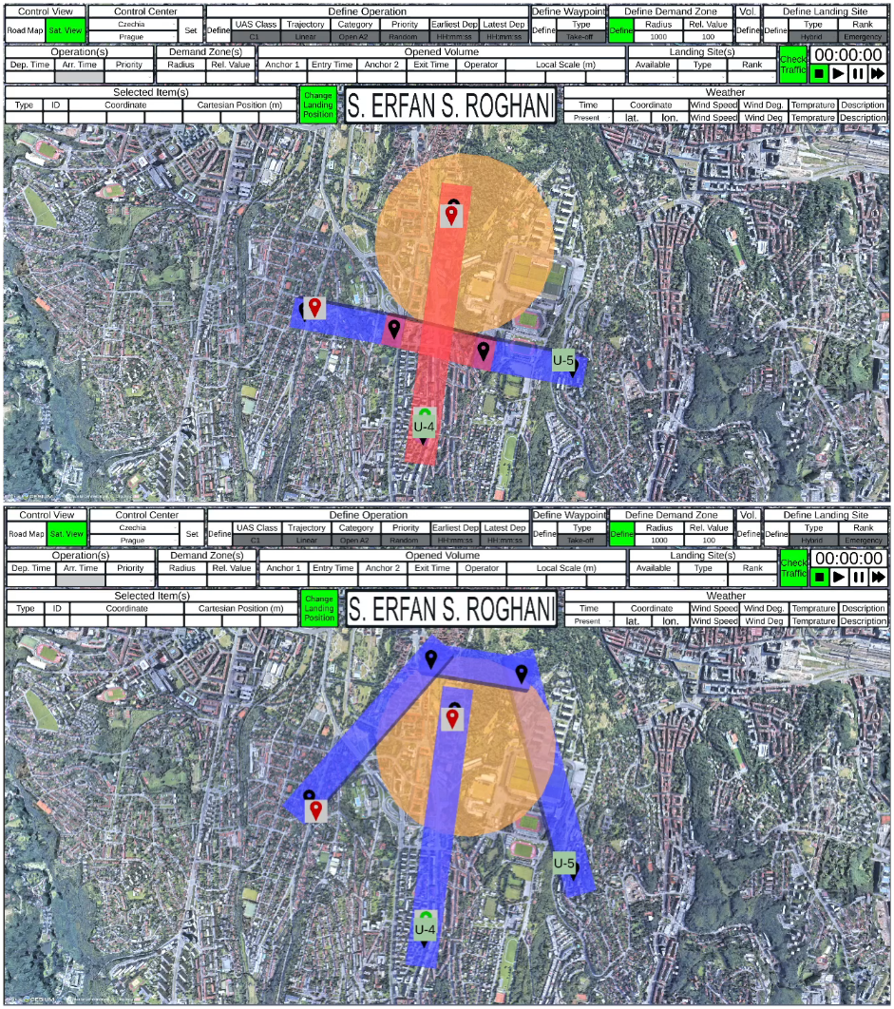
SESAR Solution 0450 – Validations
Scenario 4: Flight Plan Recommendation
Key Scenario Attributes:
Location: Prague city center
Time: Weekday, during peak business hours
Traffic Density: High, with 2–3 overlapping operations per hour
Types of Operations: Delivery, surveillance, real estate photography
Regulatory Framework: Standard airspace regulations with emergency override logic
This scenario introduces a dynamic airspace constraint—a newly declared restricted area—requiring immediate response from the system.
Metric | Description
Time to Insert Restricted Zone | Time from incident detection to zone activation in simulation | < 1 second
Time to Recommend New Plan | Time taken by the system to generate an alternate trajectory | 70 seconds.
This validation confirms that A-FPLAS is capable of detecting, processing, and responding to emergency no-fly zone declarations in real time. It efficiently reroutes only the necessary operations, maintains a priority-based order to prevent cascading conflicts, and adapts its agent hierarchy depending on the nature of the emergency.

Slide 15
SESAR Solution 0450 – Validations
Deviation from the planned activities
Multi-city plan narrowed to Prague due to UCIS prototype (airspace data available only for Prague).
Choice ensured real integration with partners’ existing infrastructure.
Simulation environment and scenarios are city/airspace-agnostic by design.
Some integrations remain conceptual:
SINTEF wind model — not yet online.
SSG Dynamic Capacity Management (DCM) — not yet online.
VZLU vertiport availability not integrated; all operations land at pre-designated, approved locations.
Impact & Mitigations: Placeholders used for:
Restricted zones.
High-demand areas.
Core A-FPLAS decision framework remains unaffected.
Architecture supports dynamic plug-in of services as they come online.
HRL agents trained with restricted-area considerations; brief fine-tuning expected for smooth adaptation to real-world data.

Slide 16

SESAR Solution 0450 – Validations

Slide 17
ESAR Solution 0450 – Benefits
Capacity
not directly assessed in the validation exercise
The simulation environment supported high volumes of concurrent UAS operations (up to 500 overlapping trajectory volumes), which stress-tested the system’s responsiveness.
Future evaluations could consider integrating formal capacity models and indicators.
Human Performance
The system operated autonomously without a human-in-the-loop.
Safety
The system’s ability to reject non-compliant U-plans and resolve trajectory conflicts contributes indirectly to enhanced safety.
A formal safety risk assessment would be needed in future stages to estimate impact on residual risk and separation assurance.
Environment
One of the agent reward components in the HRL architecture was designed to penalize operations over high-density population areas and reward those flying higher or for less time overpopulated zones. These indirect incentives suggest potential for environmental benefit.
Cost Efficiency
ECO-EVAL deliverable provides preliminary insights into cost implications of deploying such an autonomous approval system, particularly in reducing ANSP workload and enabling more efficient airspace usage.
Other Performance Considerations
The system consistently generated fair and explainable alternative trajectories using multi-agent reinforcement learning.
The architecture proved suitable for scaling and modular upgrades, and is considered operationally viable for further development.

Slide 18
Technical Aspects
Explainability
Fairness
Transparency

Slide 19
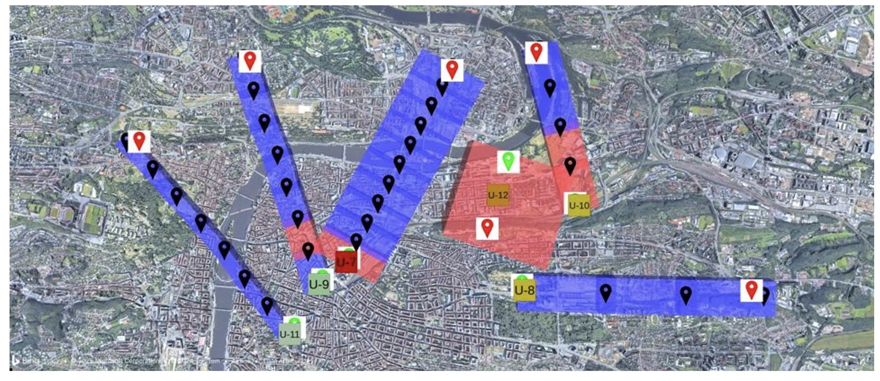
4D U-Plan Representation and Conflict Check

Slide 20
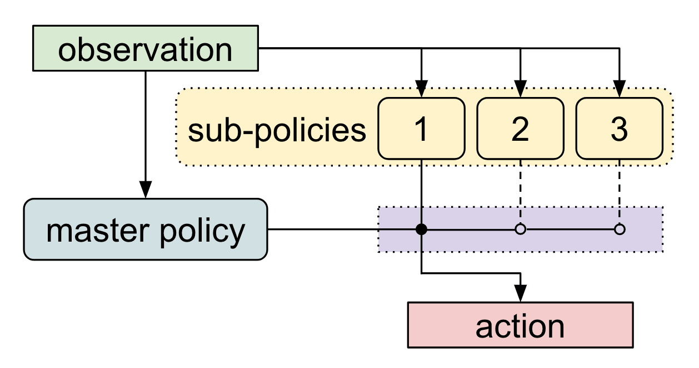
A-FPLAS Flight Plan Recommendation System Hierarchical Reinforcement Learning

Slide 21
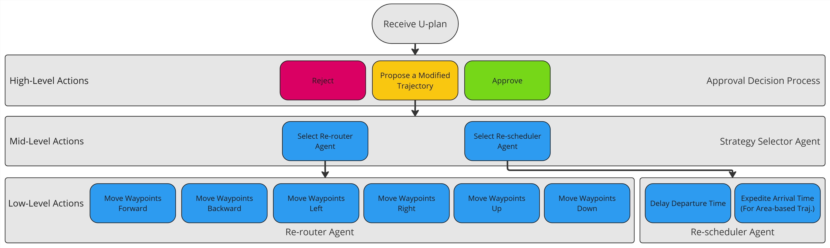
A-FPLAS Flight Plan Recommendation System

Slide 22
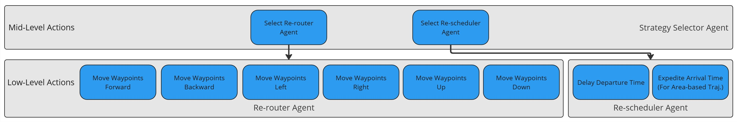
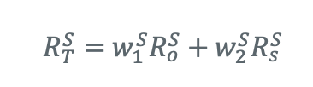
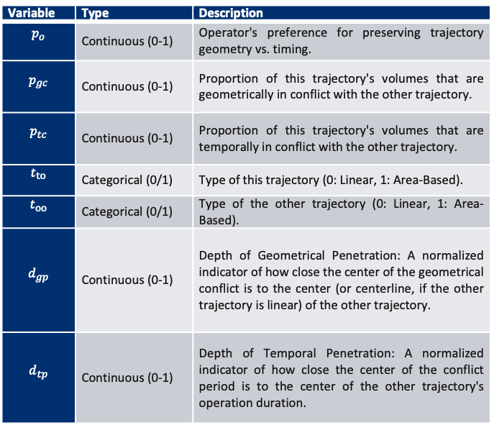
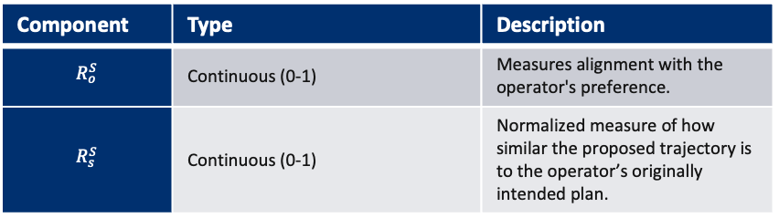
A-FPLAS Flight Plan Recommendation Strategy Selector Agent
States
Variable | Type | Description
$$p_{o}$$ | Continuous (0-1) | Operator's preference for preserving trajectory geometry vs. timing.
$$p_{gc}$$ | Continuous (0-1) | Proportion of this trajectory's volumes that are geometrically in conflict with the other trajectory.
$$p_{tc}$$ | Continuous (0-1) | Proportion of this trajectory's volumes that are temporally in conflict with the other trajectory.
$$t_{to}$$ | Categorical (0/1) | Type of this trajectory (0: Linear, 1: Area-Based).
$$t_{oo}$$ | Categorical (0/1) | Type of the other trajectory (0: Linear, 1: Area-Based).
$$d_{gp}$$ | Continuous (0-1) | Depth of Geometrical Penetration: A normalized indicator of how close the center of the geometrical conflict is to the center (or centerline, if the other trajectory is linear) of the other trajectory.
$$d_{tp}$$ | Continuous (0-1) | Depth of Temporal Penetration: A normalized indicator of how close the center of the conflict period is to the center of the other trajectory's operation duration.
Rewards
Component | Type | Description
$$R_{o}^{S}$$ | Continuous (0-1) | Measures alignment with the operator's preference.
$$R_{s}^{S}$$ | Continuous (0-1) | Normalized measure of how similar the proposed trajectory is to the operator’s originally intended plan.

Slide 23
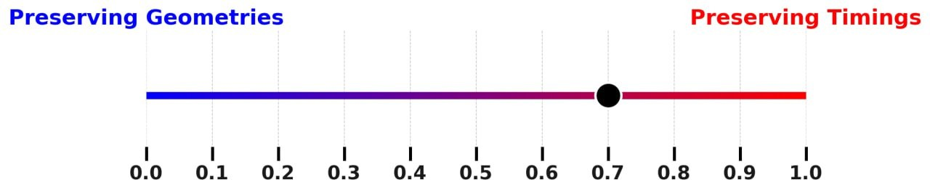
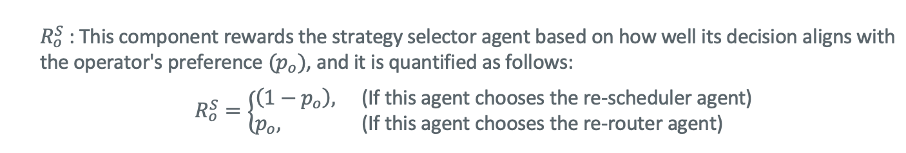
A-FPLAS Flight Plan Recommendation Strategy Selector Agent – User Preferences

Slide 24
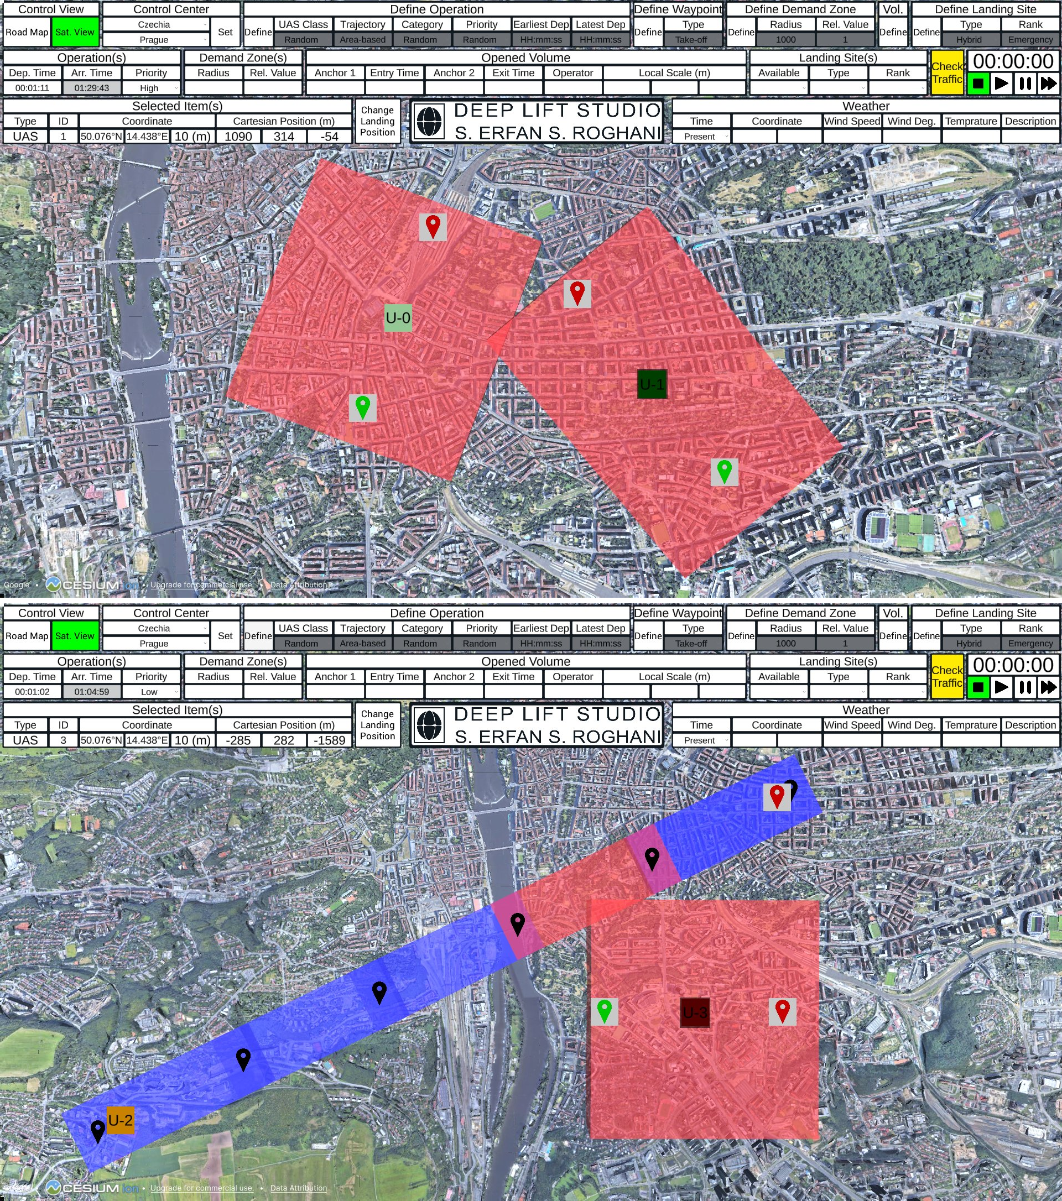
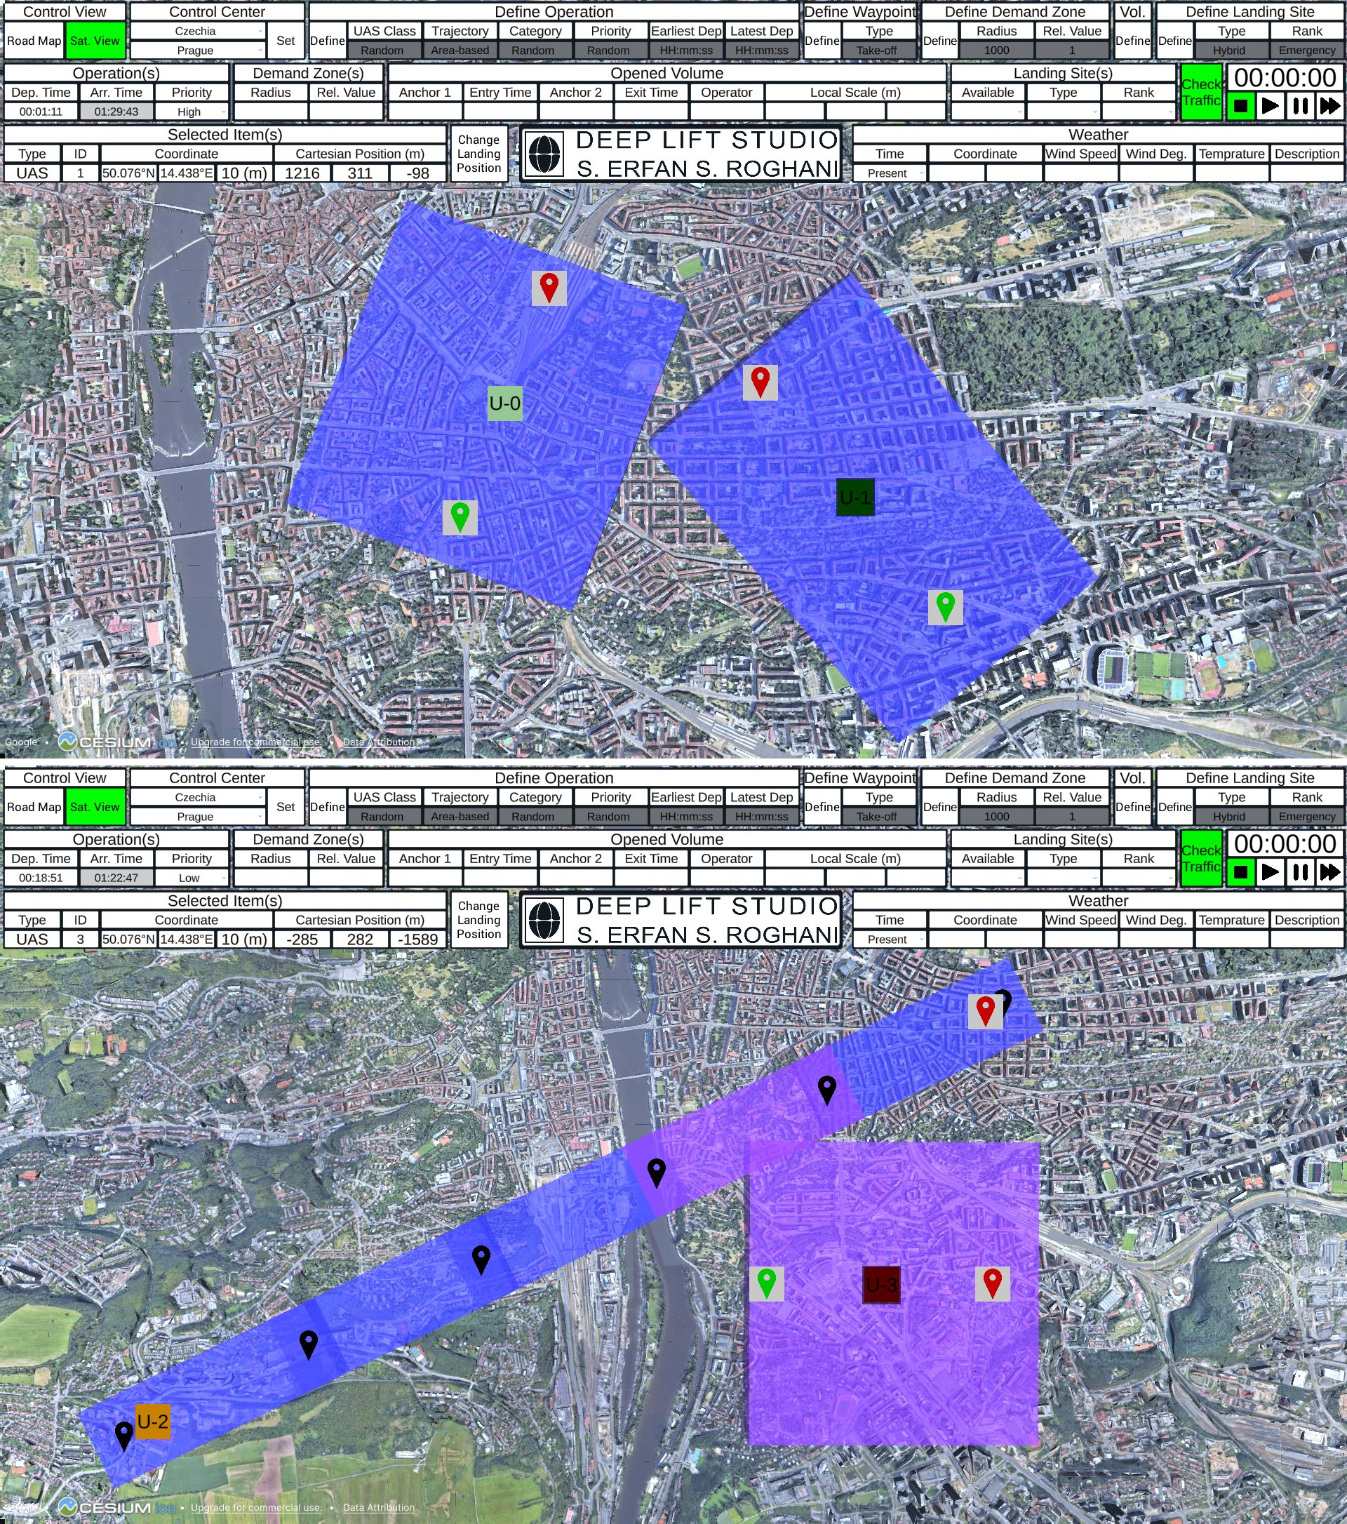
A-FPLAS Flight Plan Recommendation Strategy Selector Agent – User Preferences
Top: Re-router Agent (R) is selected.
Down: Re-Scheduler Agent (T) is selected.

Slide 25
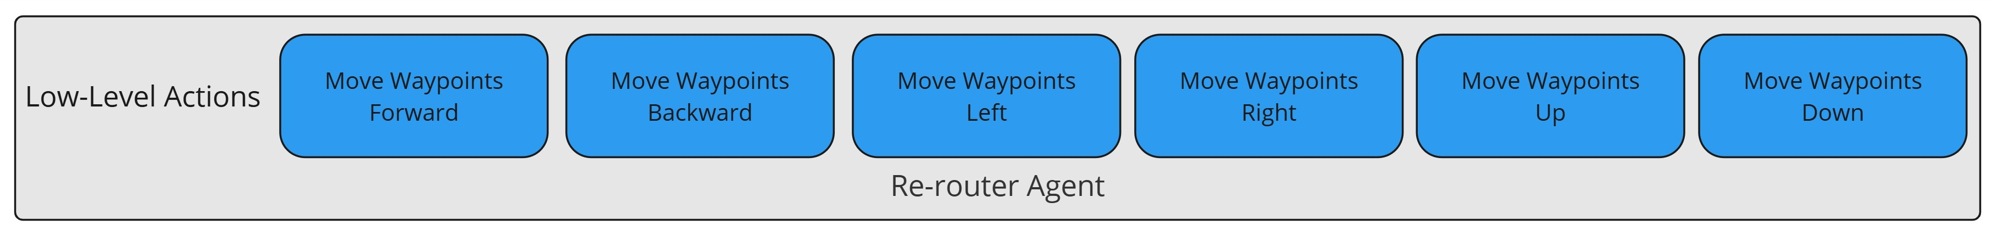
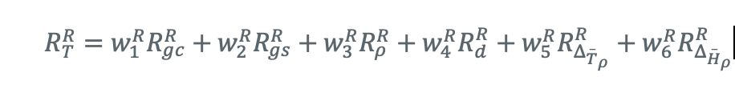
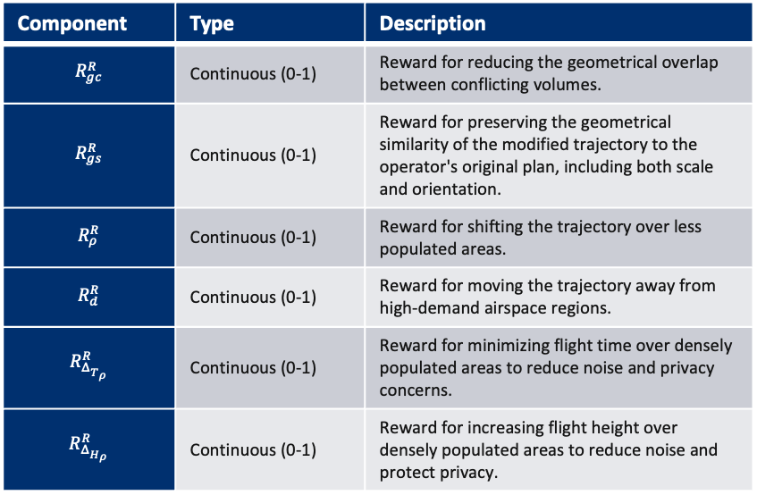
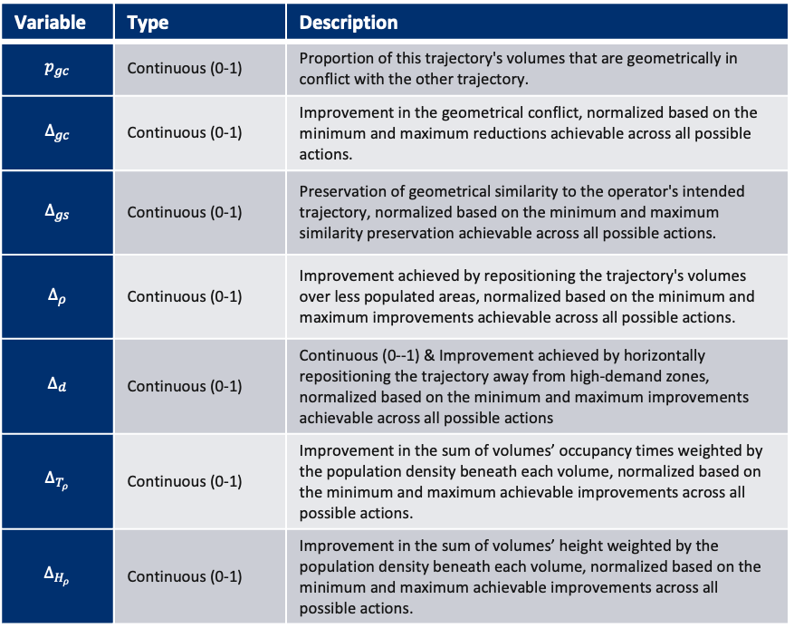
A-FPLAS Flight Plan Recommendation Re-router Agent
States
Rewards
Variable | Type | Description
$$p_{gc}$$ | Continuous (0-1) | Proportion of this trajectory's volumes that are geometrically in conflict with the other trajectory.
$$Δ_{gc}$$ | Continuous (0-1) | Improvement in the geometrical conflict, normalized based on the minimum and maximum reductions achievable across all possible actions.
$$Δ_{gs}$$ | Continuous (0-1) | Preservation of geometrical similarity to the operator's intended trajectory, normalized based on the minimum and maximum similarity preservation achievable across all possible actions.
$$Δ_{ρ}$$ | Continuous (0-1) | Improvement achieved by repositioning the trajectory's volumes over less populated areas, normalized based on the minimum and maximum improvements achievable across all possible actions.
$$Δ_{d}$$ | Continuous (0-1) | Continuous (0--1) & Improvement achieved by horizontally repositioning the trajectory away from high-demand zones, normalized based on the minimum and maximum improvements achievable across all possible actions
$$Δ_{{\overset{‾}{T}}_{ρ}}$$ | Continuous (0-1) | Improvement in the sum of volumes’ occupancy times weighted by the population density beneath each volume, normalized based on the minimum and maximum achievable improvements across all possible actions.
$$Δ_{{\overset{‾}{H}}_{ρ}}$$ | Continuous (0-1) | Improvement in the sum of volumes’ height weighted by the population density beneath each volume, normalized based on the minimum and maximum achievable improvements across all possible actions.
Component | Type | Description
$$R_{gc}^{R}$$ | Continuous (0-1) | Reward for reducing the geometrical overlap between conflicting volumes.
$$R_{gs}^{R}$$ | Continuous (0-1) | Reward for preserving the geometrical similarity of the modified trajectory to the operator's original plan, including both scale and orientation.
$$R_{ρ}^{R}$$ | Continuous (0-1) | Reward for shifting the trajectory over less populated areas.
$$R_{d}^{R}$$ | Continuous (0-1) | Reward for moving the trajectory away from high-demand airspace regions.
$$R_{Δ_{{\overset{‾}{T}}_{ρ}}}^{R}$$ | Continuous (0-1) | Reward for minimizing flight time over densely populated areas to reduce noise and privacy concerns.
$$R_{Δ_{{\overset{‾}{H}}_{ρ}}}^{R}$$ | Continuous (0-1) | Reward for increasing flight height over densely populated areas to reduce noise and protect privacy.

Slide 26
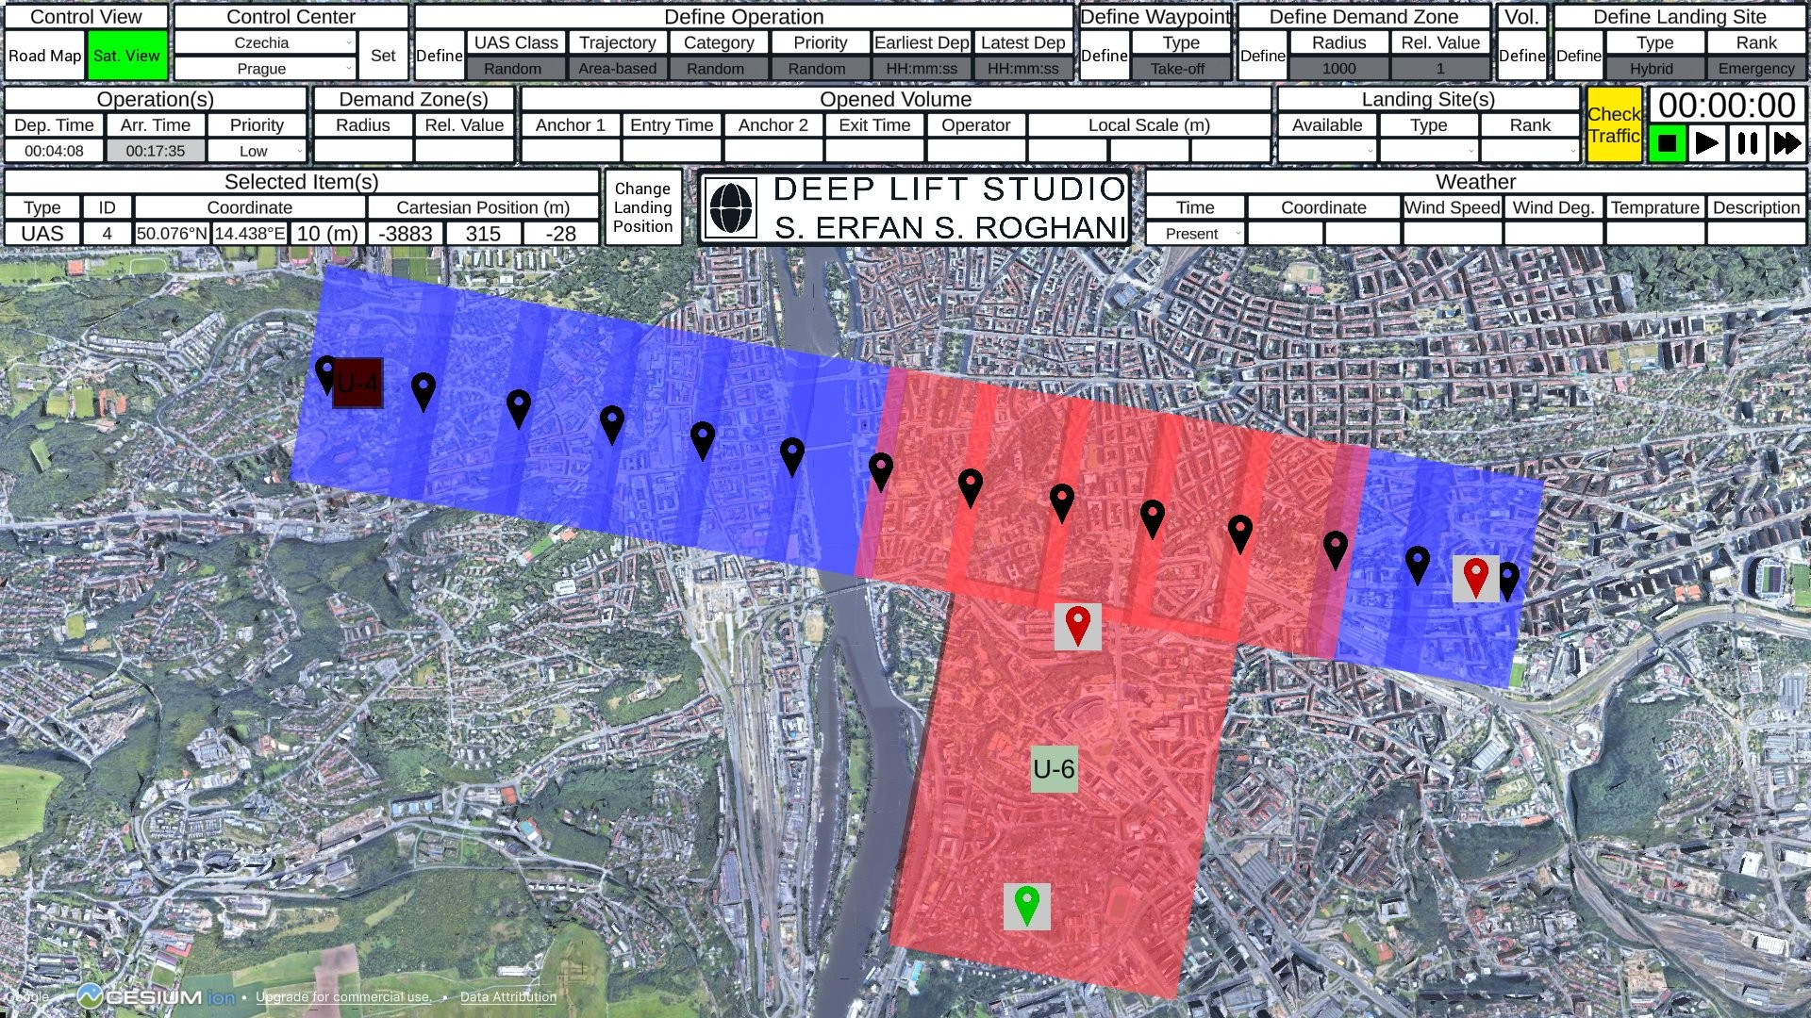
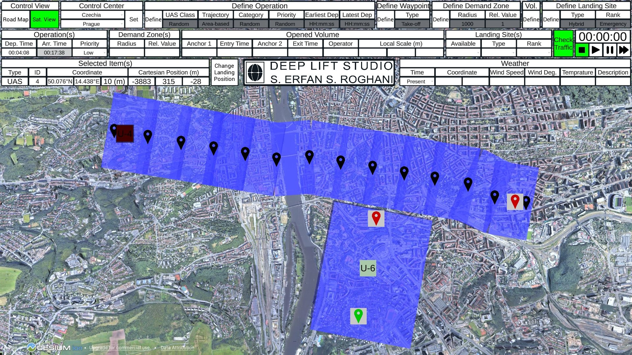
A-FPLAS Flight Plan Recommendation Re-router Agent

Slide 27
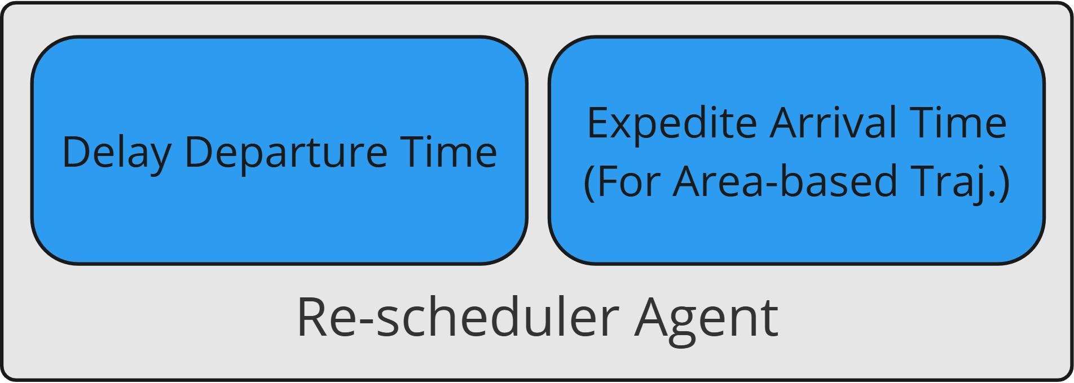
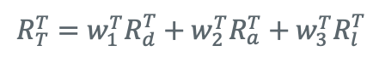
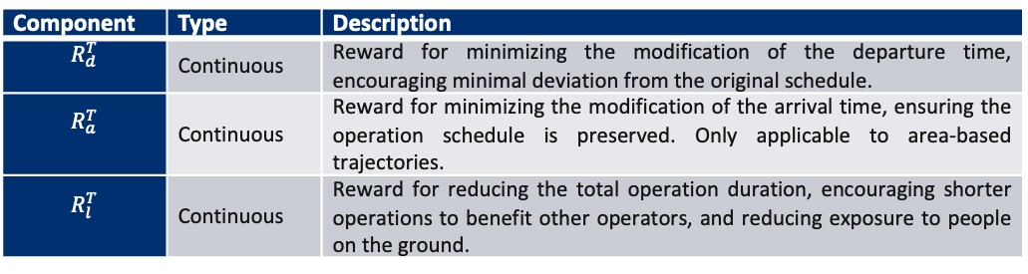
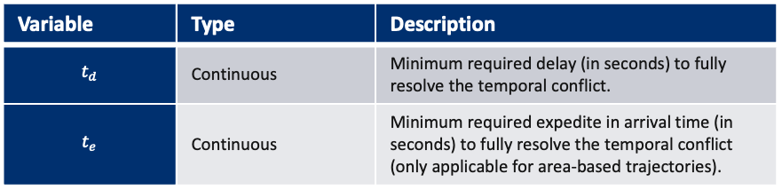
A-FPLAS Flight Plan Recommendation Re-schedular Agent
States
Variable | Type | Description
$$t_{d}$$ | Continuous | Minimum required delay (in seconds) to fully resolve the temporal conflict.
$$t_{e}$$ | Continuous | Minimum required expedite in arrival time (in seconds) to fully resolve the temporal conflict (only applicable for area-based trajectories).
Rewards
Component | Type | Description
$$R_{d}^{T}$$ | Continuous | Reward for minimizing the modification of the departure time, encouraging minimal deviation from the original schedule.
$$R_{a}^{T}$$ | Continuous | Reward for minimizing the modification of the arrival time, ensuring the operation schedule is preserved. Only applicable to area-based trajectories.
$$R_{l}^{T}$$ | Continuous | Reward for reducing the total operation duration, encouraging shorter operations to benefit other operators, and reducing exposure to people on the ground.

Slide 28
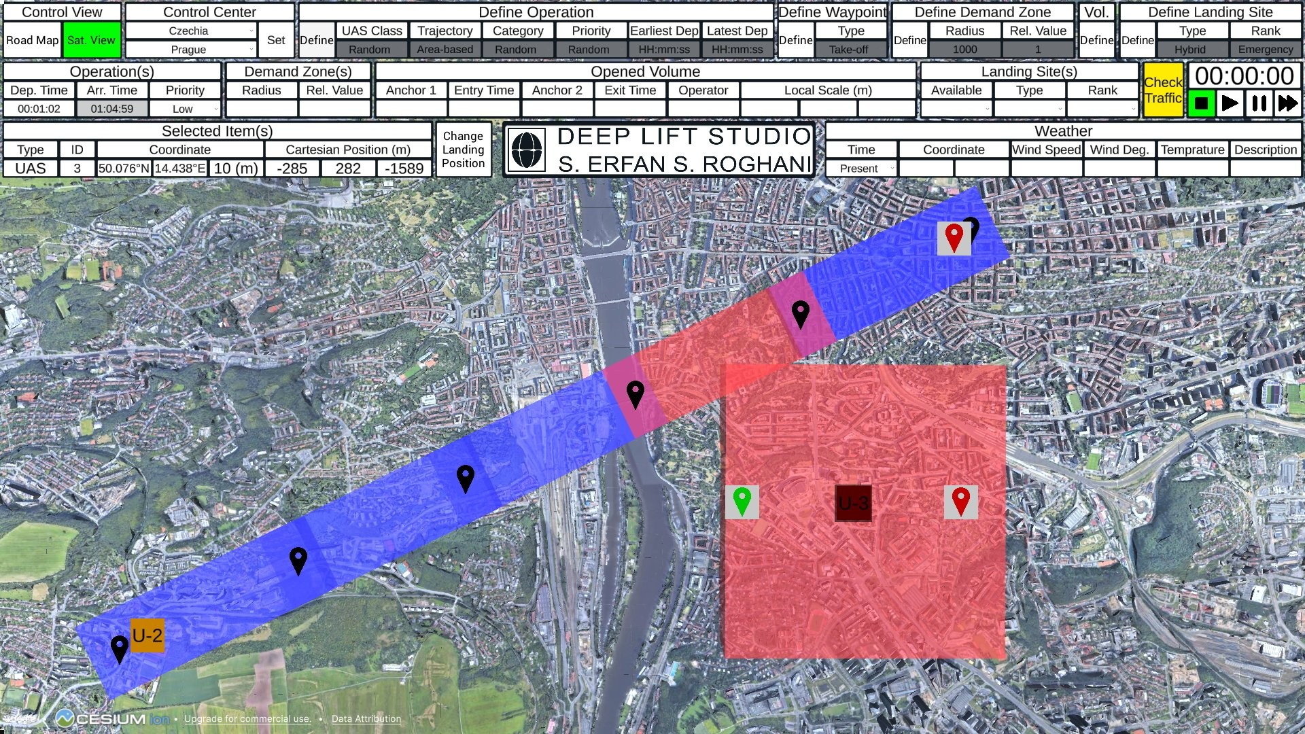
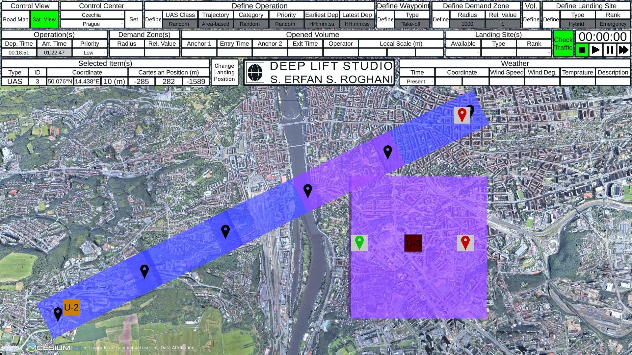
A-FPLAS Flight Plan Recommendation Re-schedular Agent

Slide 29
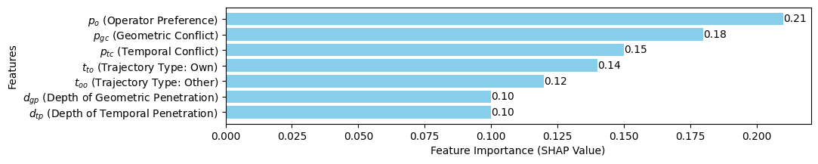
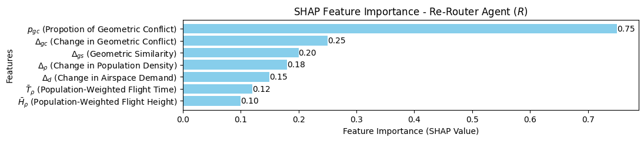
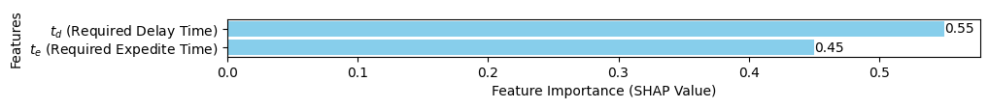
A-FPLAS Flight Plan Recommendation Explainability – SHAPley Values
SHAP Feature Importance – Strategy Selector Agent
SHAP Feature Importance – Re-router Agent
SHAP Feature Importance – Re-schedular Selector Agent

Slide 30
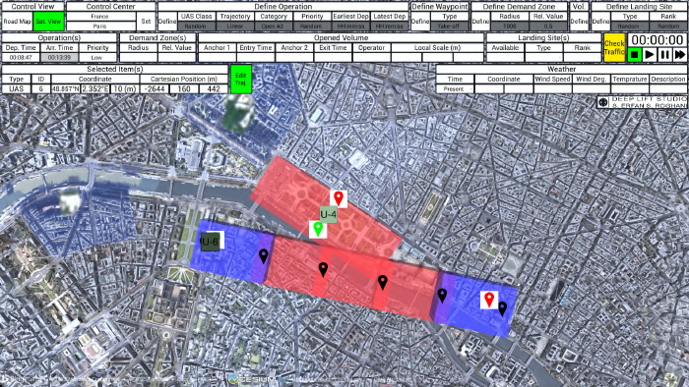
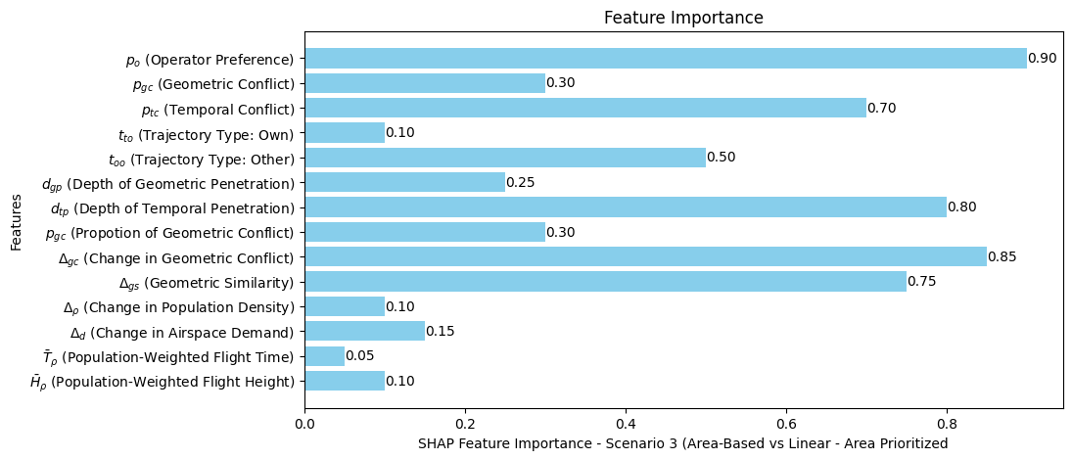
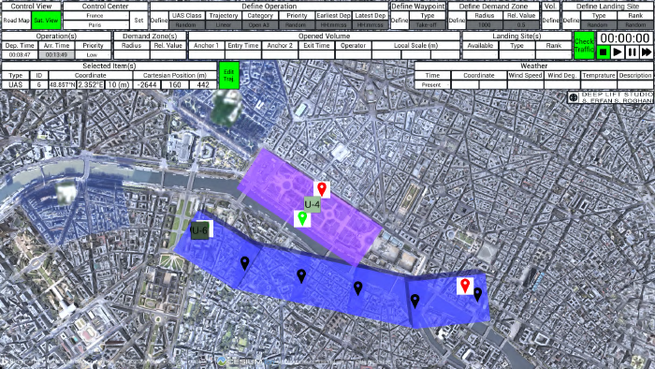
A-FPLAS Flight Plan Recommendation Explainability – SHAPley Values - Examples

Slide 31
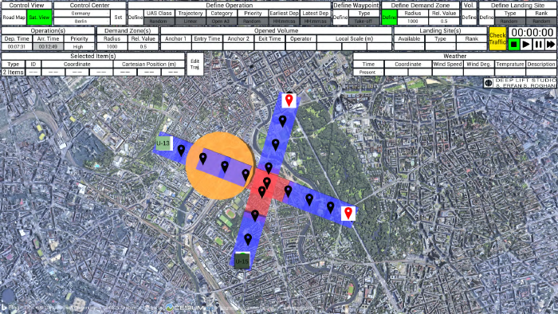
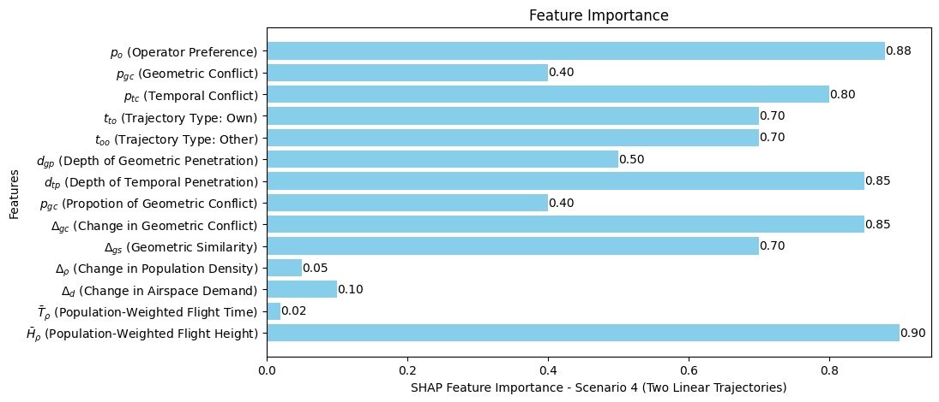
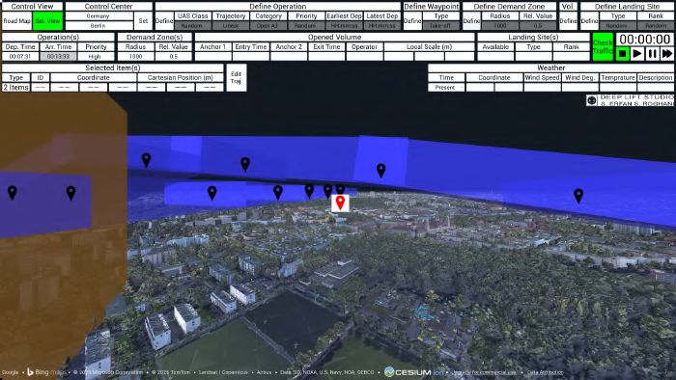
A-FPLAS Flight Plan Recommendation Explainability – SHAPley Values - Examples

